Slide 1

DWBI PROJECT GROUP 5 – SPRING 2021
Reema Yadav
Sakshi Patil
Shouvik Ash
Ashi Chaturvedi

Slide 2

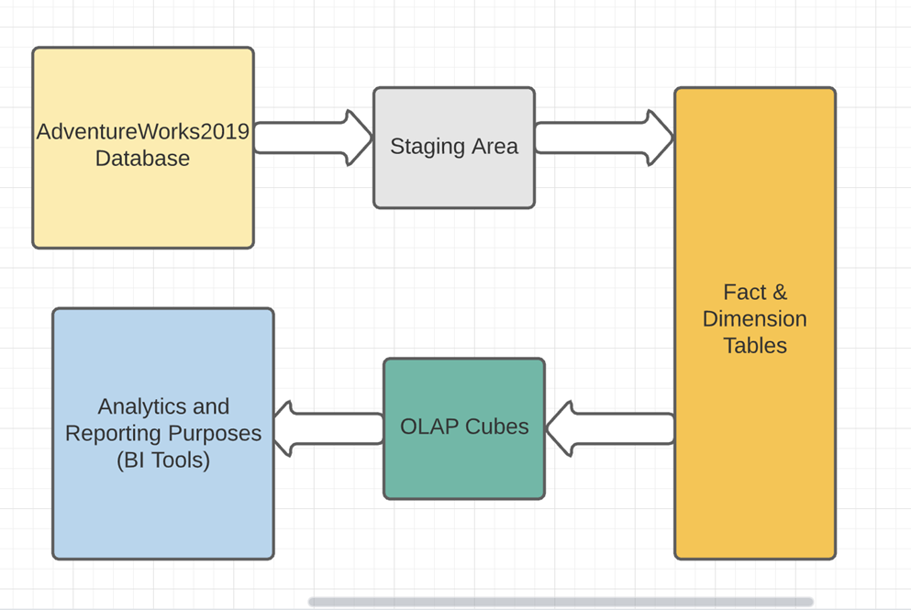
HOW WILL DATA FLOW?

Slide 3
WHAT TABLES ARE REQUIRED?
Different tables used:
Source tables
Fact tables
Dimension tables

Slide 4
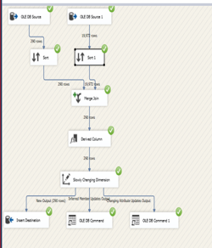
SLOWLY CHANGING DIMENSIONS
A SCD is a dimension that stores and manages both current and historical data over time in a data warehouse.
Types of SCD:
Type 0 – Fixed dimension
Type 1 – No history
Type 2 – Row versioning
Type 3 – Previous value column
Type 4 – History table
Type 6 – Hybrid SCD

Slide 5
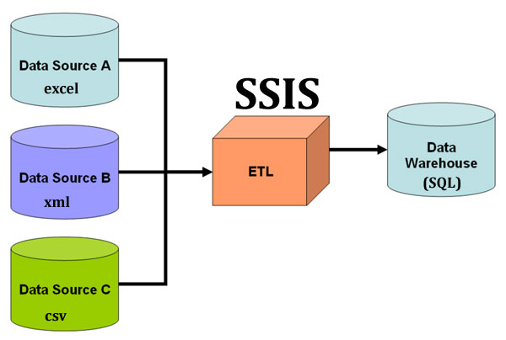
EXTRACT TRANSFORM LOAD
ETL stands for Extract, Transform and Load, which is a process used to collect data from various sources, transform the data depending on business rules/needs and load the data into a destination database.
SSIS is used in this project for ETL.
Different sources can be used.

Slide 6
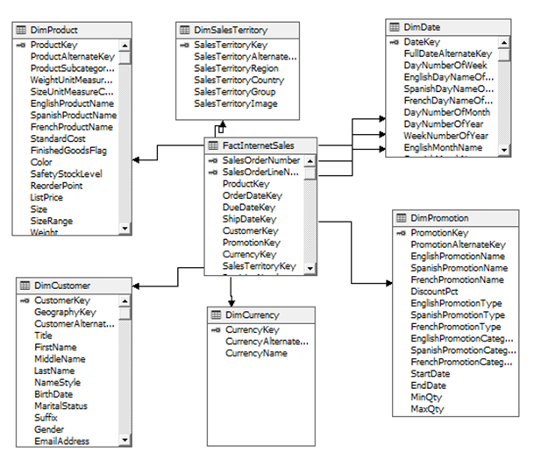
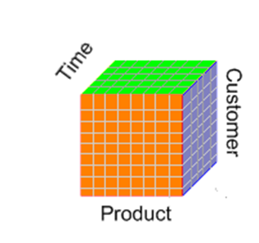
OLAP CUBE
An OLAP cube is a data structure that overcomes the limitations of relational databases by providing rapid analysis of data.
Cubes can display and sum large amounts of data while also providing users with searchable access to any data points. These cubes are stored in SQL Server Analysis Services (SSAS).

Slide 7
ANALYSIS – TOTAL SALES AMOUNT

Slide 8
TOTAL YEARLY INCOME OF MALE AND FEMALE

Slide 9
UNIT COST DURING THE PERIOD OF TIME

